Slide 1
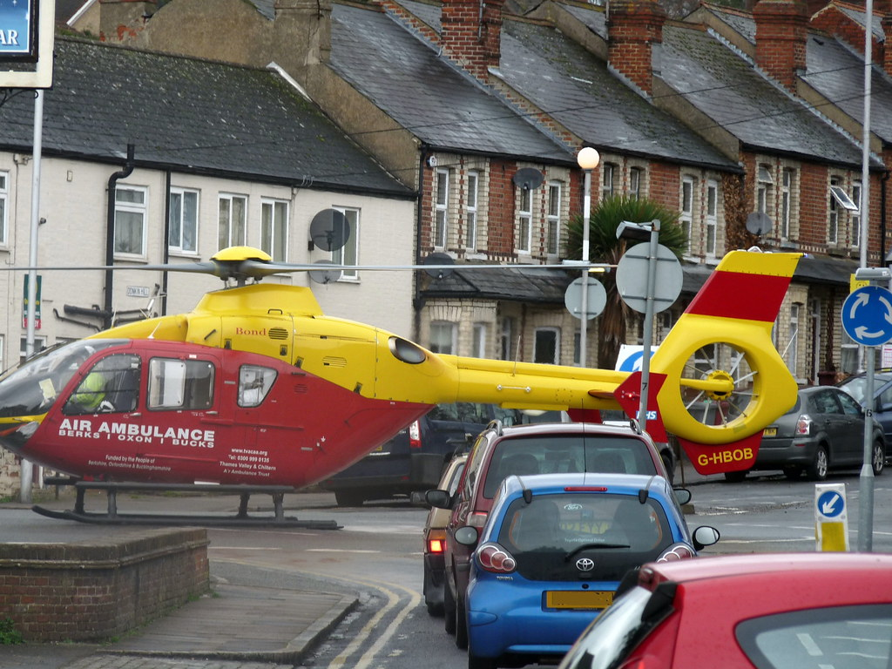
Road Casualty Analysis

Slide 2
Data source
Data source: https://data.gov.uk/
Road Casualty Analysis

Slide 3
Objective
To identify key factor of fatal and serious road casualty of driver and rider in 2020
To provide recommendation
Road Casualty Analysis

Slide 4
Fatal case
Serious case
Road Casualty Analysis

Slide 5
Recommendation
Fatal case
For general public
Person over 60 should travel by public transportation (if feasible), as if casualty happens, it is more likely that it is a fatal casualty.
Male should travel by car, instead of motorcycle or bicycle (if feasible), as the risk of fatal and serious casualty is higher than travel by car.
For government
Government may need to implement bicycle license for rider.
For insurance company
Higher insurance premium should be collected from male with motorcycle or bicycle, as risk of fatal and serious casualty is higher.
For motorcycle company
To review whether motorcycle and bicycle could be enhanced (launch a new product with higher profit margin) to reduce casualty for male.
Serious case
Road Casualty Analysis

